Slide 1
Eclipse IDE and Debugging
Eclipse IDE and Debugging
Ravikishore Kommajosyula
Ravikishore Kommajosyula

Slide 2
What is an IDE?
Software application that provide several features that assist a computer programmer in efficient software development.
An IDE typically consists of:
Source code editor
Build automation tools
Debugger
Class browser
Automatic code completion

Slide 3
Advantages and Disadvantages
Advantages:
Makes you efficient, helps organize resources, prevent mistakes, provide shortcuts
Automates build process
Project management tools : Version controlling, Documentation tools etc.
Disadvantages:
Using GUI consumes more resources, and may not be possible always (SSH)
Learning to use all features is time consuming

Slide 4
Eclipse CDT
Provides fully functional C and C++ IDE based on the Eclipse platform
Automates build process
Installation:
http://www.eclipse.org/cdt/downloads.php
Unzip the package and open the eclipse binary

Slide 5
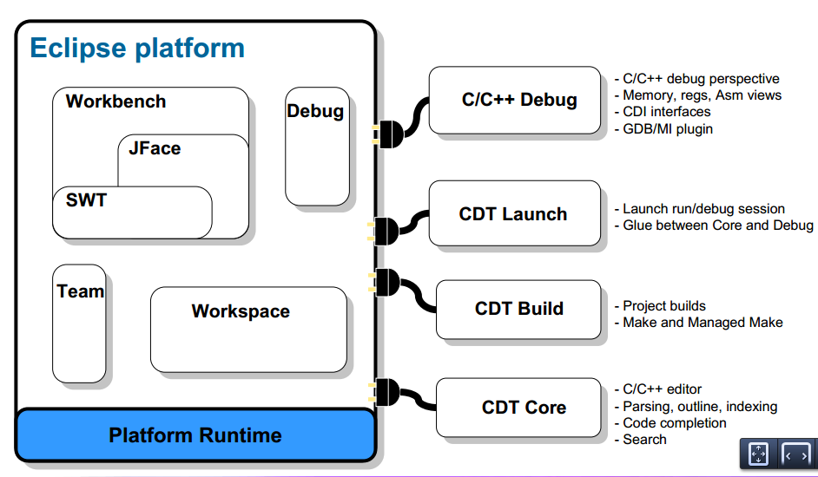
Eclipse IDE

Slide 6
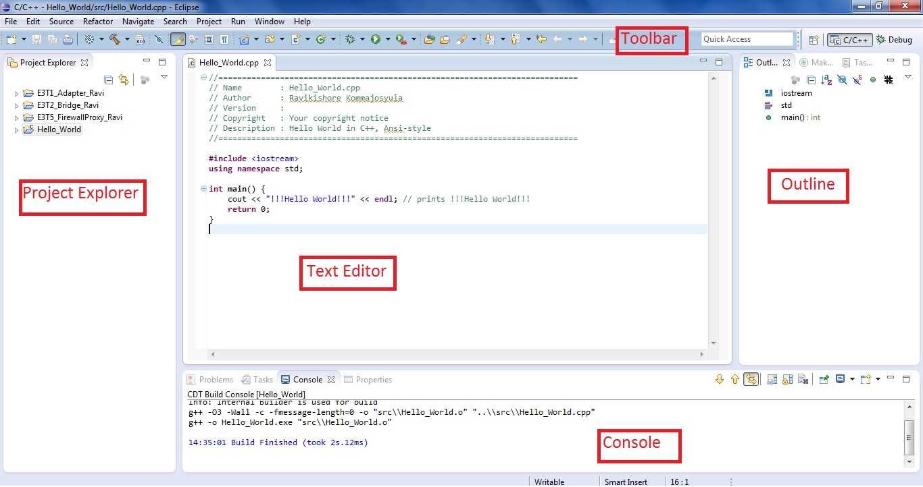
Eclipse CDT User Interface

Slide 7
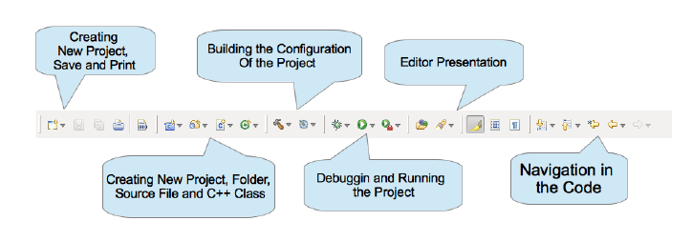
Eclipse Toolbar
Quick access to several frequently used commands / functionalities

Slide 8
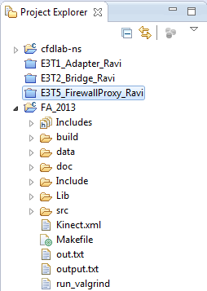
Project Explorer
Provides a handy way of exploring files in one project / open and close different projects in the workspace

Slide 9
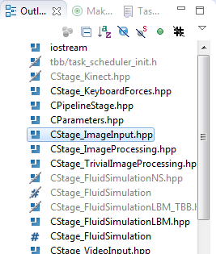
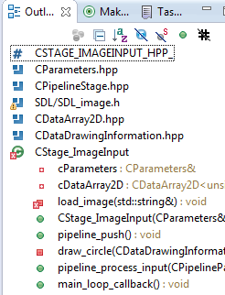
Outline
Gives a quick view of the contents of the file. Very useful to understand a new code / debug

Slide 10
Other key features
Integration with Git and SVN
Code auto completion – Ctrl + Space
Navigate to function declaration / header – Ctrl + Left-Click or F3
Code auto formatting – Ctrl + Shift + F
Code refactoring– Alt + Shift + R, Alt+ Shift + M
Commenting block of code – Ctrl + /
And many many more…

Slide 11
Debugging
Debugging is the process of locating and fixing errors (bugs) in the code
Classical approach to debugging – printf()….not the smartest way to go!!
Debugging information can be generated from code by adding the –g flag
Compiler optimization flags might alter code
Examples – gdb, valgrind, visual studio etc.

Slide 12
Why we need Debuggers?
Seeing the source code during the execution of a statement
Pause the execution at any point in the source code
Read the current state of the program when execution is paused
See the call stack, set break points, step into / out of a function etc.

Slide 13
Call Stack
Program execution starts by calling main function
Several functions are called within the program
All function calls are stored (along with local variables and return address) on the Call Stack
Call stack gives very helpful information for debugging
Especially helpful for recursive algorithms

Slide 14
Breakpoints
Program execution stops and control is handed over to the user once the execution hits a Breakpoint
Very powerful tool when used in the right way
Special types of breakpoints give advanced features:
Watch point : Program execution is stopped whenever a particular data value is changed (track a variable)
Conditional breakpoint: Program execution is stopped whenever a condition is met (dt < 0)

Slide 15
Stepping
Stepping is the process of stepping into the code and running it one step at a time
Step Into: Executes current statement. If the statement is a function, it steps into the function
Step Over: Executes current statement. If the statement if the function, it executes the whole function (step over) and stops at next statement
Step Out: Steps out of current function
Continue: Execution till the end / next breakpoint

